Slide 1

STUDENT PERFORMANCE ANALYTICS USING BIG DATA TOOLS
Capstone Project – Introduction to Big Data Analytics
Gabin NIYONIZEYE
26653
AUCA | Academic Year 2024–2025

Slide 2
Project Overview
📌 Problem:
How do study time, absences, and academic failures affect students' final grades?
🛠 Tools Used:
- Python (for data analysis and modeling)
- Power BI (for visualization)
🎯 Objective:
Use real-world data to build insights and predictive models that help track student performance.

Slide 3
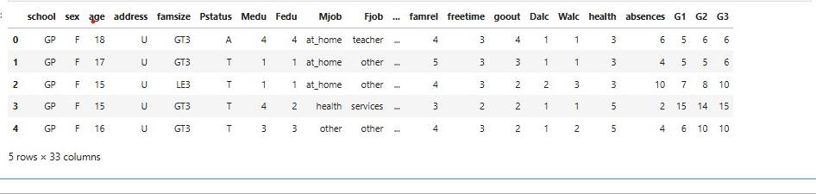
Dataset Summary
📊 Dataset: UCI Student Performance
- 395 rows, 33 columns
- CSV format
- No missing values

Slide 4
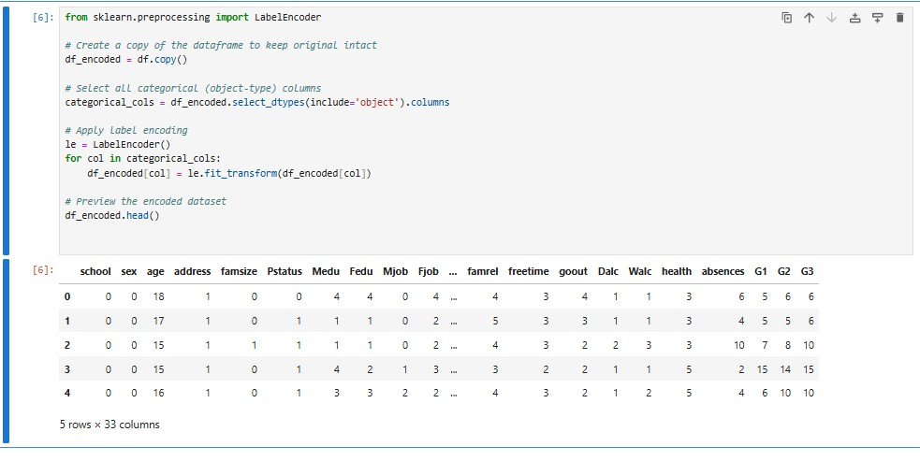

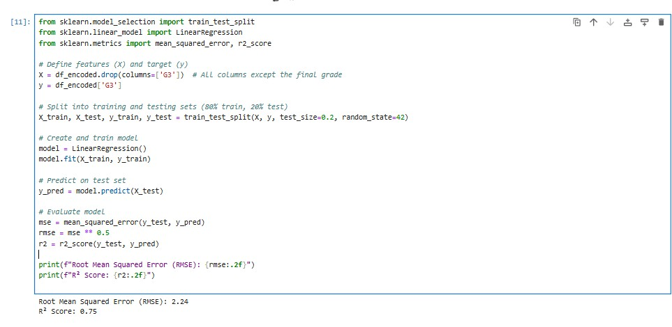
Data Cleaning & Modeling
✔ Preprocessing:
Categorical encoding with LabelEncoder
✔ Modeling:
- Linear Regression
- R² = 0.75 | RMSE = 2.24

Slide 5
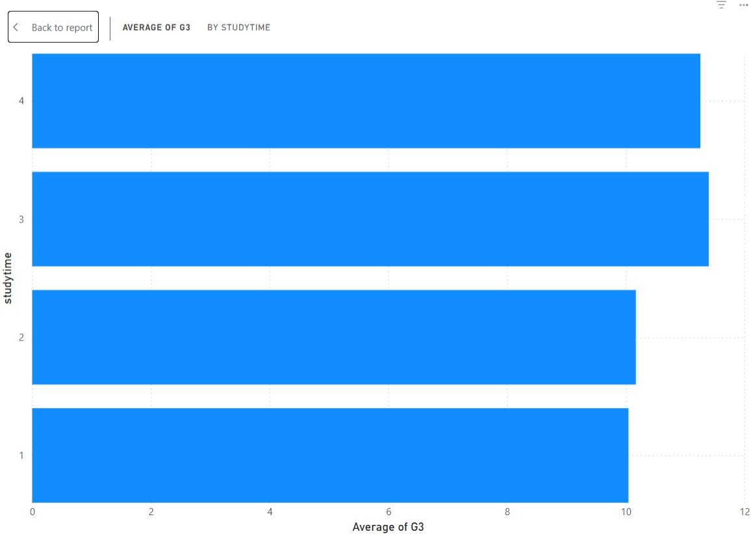
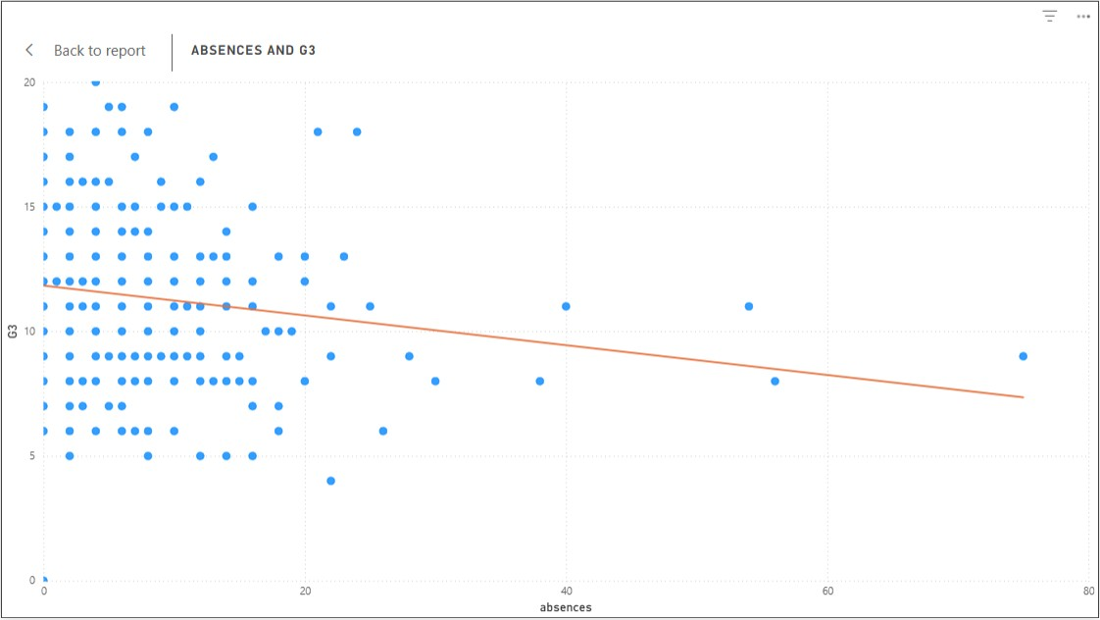
Power BI Visuals (Main Dashboard)
📈 Visualizing Factors Affecting Grades
Final Grade vs Study Time – Power BI bar chart
Scatter plot with trendline showing impact of absences on final grade

Slide 6
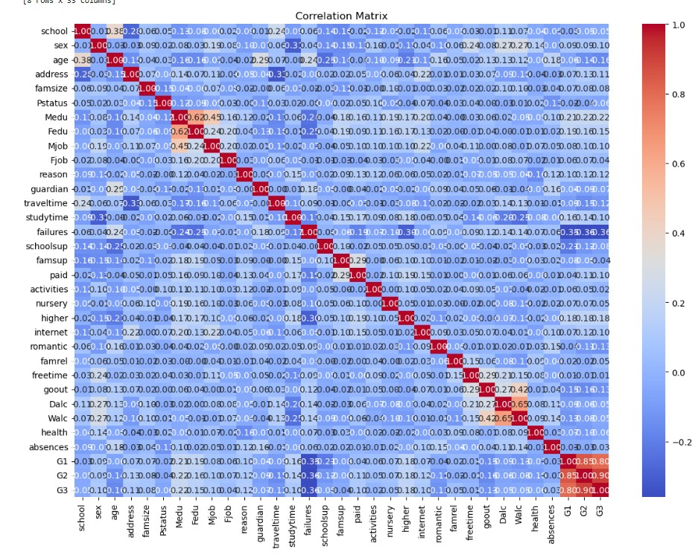
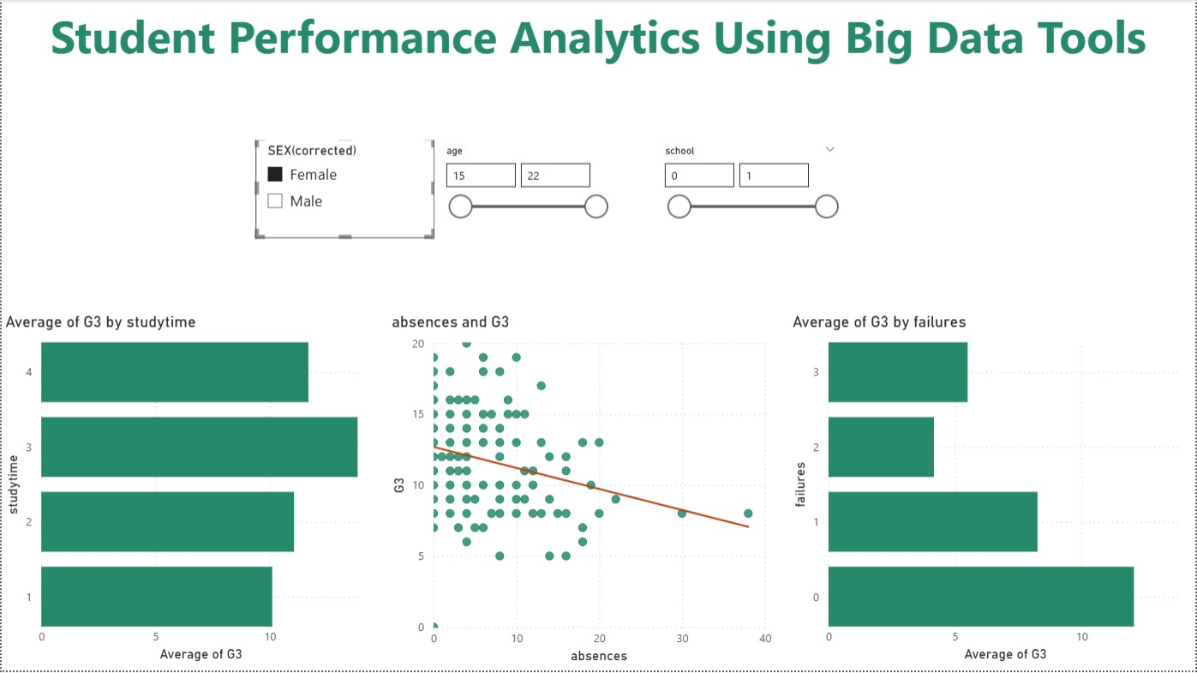
Combined Visual Insights
🔍 Insight Summary:
- More study time = higher grades
- Absences strongly reduce performance
- More failures = lower average grades

Slide 7
Recommendations & Future Work
📌 Recommendations:
- Monitor students with high absences/failures
- Encourage consistent study habits
- Use analytics tools to identify at-risk learners
📌 Future Work:
- Try more complex models (Random Forest, XGBoost)
- Add behavioral or attendance datasets

Slide 8
Thank you for your attention!
“Whatever you do, work at it with all your heart…” – Colossians 3:23

